Slide 1
Introduction to Image Recognition with OpenCV
Ming Chi University of Techology
Mechanical Engineering Department
Prof. Meng-Jey Youh Ph.D

Slide 2
Tesseract OCR & Pytesseract
OCR
Introduction
Open Source OCR Tools
Tesseract OCR
Technology - How it works
Install Tesseract-OCR and pytesseract
OCR with Pytesseract and OpenCV
Getting boxes around text
Preprocessing for Tesseract

Slide 3
Introduction
OCR = Optical Character Recognition. In other words, OCR systems transform a two-dimensional image of text, that could contain machine printed or handwritten text from its image representation into machine-readable text. OCR as a process generally consists of several sub-processes to perform as accurately as possible. The sub processes are:
Preprocessing of the Image
Text Localization
Character Segmentation
Character Recognition
Post Processing

Slide 4
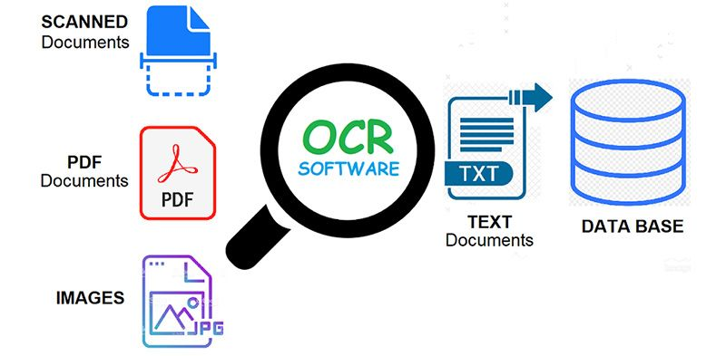
What can OCR do?

Slide 5
Open Source OCR Tools
Tesseract - an open-source OCR engine that has gained popularity among OCR developers.
Tesseract began as a Ph.D. research project in HP Labs, Bristol U.
It gained popularity and was developed by HP between 1984 and 1994.
In 2005 HP released Tesseract as an open-source software.
Since 2006 it is developed by Google.

Slide 6
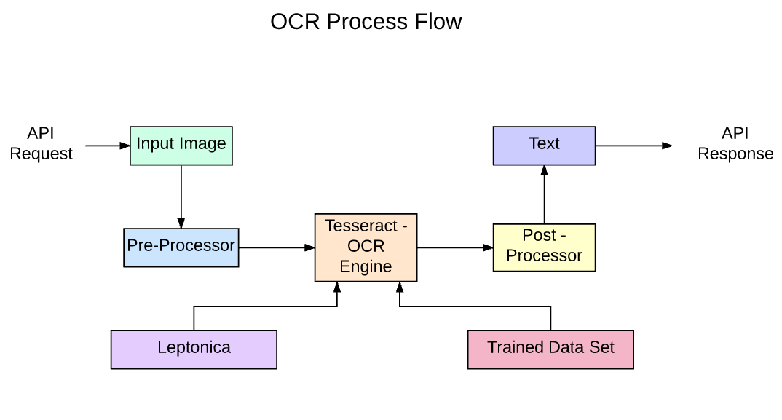
Tesseract OCR

Slide 7
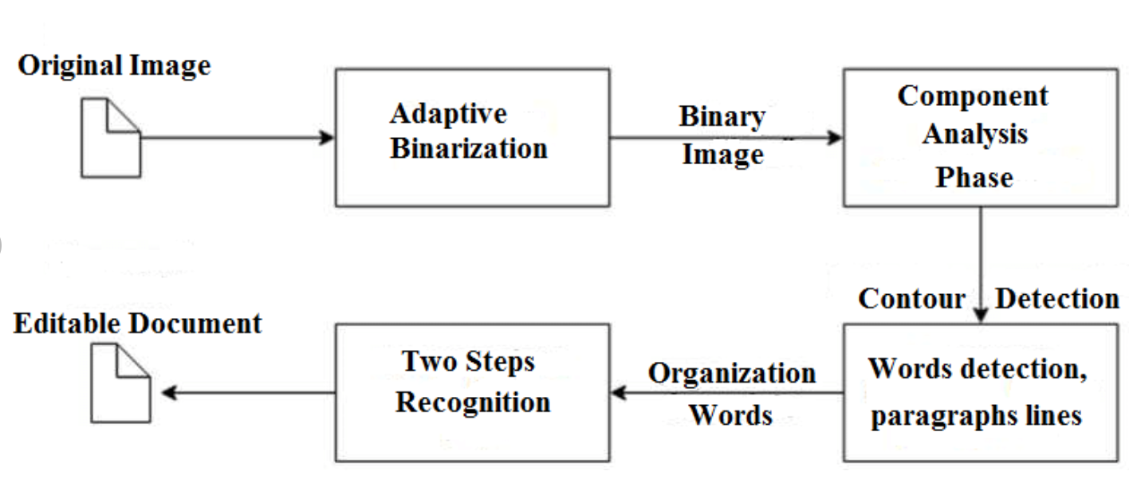
Tesseract 3 OCR process

Slide 8
Tesseract 4.00 includes a new neural network subsystem configured as a text line recognizer. It has its origins in OCRopus' Python-based LSTM implementation but has been redesigned for Tesseract in C++. The neural network system in Tesseract pre-dates TensorFlow but is compatible with it, as there is a network description language called Variable Graph Specification Language (VGSL), that is also available for TensorFlow.
To recognize an image containing a single character, we typically use a Convolutional Neural Network (CNN). Text of arbitrary length is a sequence of characters, and such problems are solved using RNNs and LSTM is a popular form of RNN. Read this post to learn more about LSTM.

Slide 9
Install Tesseract-OCR and pytesseract in windows 10 environment (anaconda)
https://tesseract-ocr.github.io/tessdoc/Home.html
https://github.com/UB-Mannheim/tesseract/wiki
tesseract-ocr-w32-setup-v5.0.0-alpha.20200328.exe (32 bit)
tesseract-ocr-w64-setup-v5.0.0-alpha.20200328.exe (64 bit)
https://github.com/tesseract-ocr/tessdoc
installation is complete, directly cmd input:
tesseract -v

Slide 10
Install pytesseract
Pytesseract
Python-tesseract is a wrapper for Google’s Tesseract-OCR Engine. It is also useful as a stand-alone invocation script to tesseract, as it can read all image types supported by the Pillow and Leptonica imaging libraries, including jpeg, png, gif, bmp, tiff, and others. Additionally, if used as a script, Python-tesseract will print the recognized text instead of writing it to a file.
conda install -c conda-forge pytesseract

Slide 11
OCR with Pytesseract and OpenCV(ex01)
import cv2
import pytesseract
import numpy as np
img = cv2.imread("OCR.PNG")
pytesseract.pytesseract.tesseract_cmd = 'C:\\Program Files\\Tesseract-OCR\\tesseract.exe'
print(pytesseract.get_tesseract_version())
text = pytesseract.image_to_string(img, lang="eng")
print(text[0:len(text)-1])
cv2.namedWindow('original', cv2.WINDOW_NORMAL)
cv2.imshow('original', img)
cv2.waitKey(0)
cv2.destroyAllWindows()

Slide 12
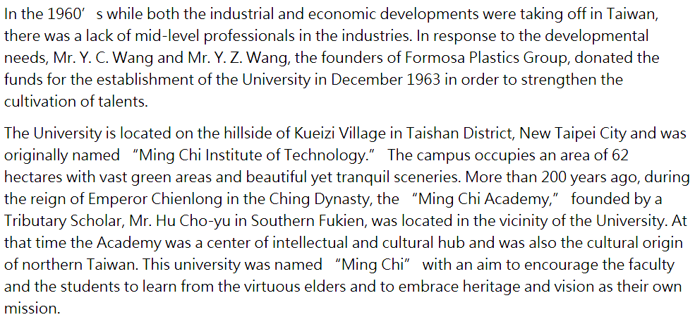
OCR.PNG
In the 1960’ s while both the industrial and economic developments were taking off in Taiwan,
there was a lack of mid-level professionals in the industries. In response to the developmental
needs, Mr. Y. C. Wang and Mr. Y. Z. Wang, the founders of Formosa Plastics Group, donated the
funds for the establishment of the University in December 1963 in order to strengthen the
cultivation of talents.
The University is located on the hillside of Kueizi Village in Taishan District, New Taipei City and was
originally named “Ming Chi Institute of Technology.” The campus occupies an area of 62
hectares with vast green areas and beautiful yet tranquil sceneries. More than 200 years ago, during
the reign of Emperor Chienlong in the Ching Dynasty, the “Ming Chi Academy,” founded by a
Tributary Scholar, Mr. Hu Cho-yu in Southern Fukien, was located in the vicinity of the University. At
that time the Academy was a center of intellectual and cultural hub and was also the cultural origin
of northern Taiwan. This university was named “Ming Chi” with an aim to encourage the faculty
and the students to learn from the virtuous elders and to embrace heritage and vision as their own
mission.
Text

Slide 13
Getting boxes around text (ex02)
import cv2
import pytesseract
import numpy as np
img = cv2.imread("OCR.PNG")
img2=img.copy()
h, w, c = img.shape
pytesseract.pytesseract.tesseract_cmd = 'C:\\Program Files\\Tesseract-OCR\\tesseract.exe'
boxes = pytesseract.image_to_boxes(img)
for b in boxes.splitlines():
b = b.split(' ')
img2 = cv2.rectangle(img2, (int(b[1]), h - int(b[2])), (int(b[3]), h - int(b[4])), (0, 255, 0), 1)
text = pytesseract.image_to_string(img, lang="eng")
print(text[0:len(text)-1])
cv2.imshow('original', img)
cv2.imshow('boxes', img2)
cv2.waitKey(0)
cv2.destroyAllWindows()

Slide 14
Preprocessing for Tesseract
Prep4Tesseract.py
def get_grayscale(image): # get grayscale image
def remove_noise(image): # noise removal
def thresholding(image): #thresholding
def dilate(image):#dilation
def erode(image):#erosion
def opening(image):#opening - erosion followed by dilation
def canny(image):#canny edge detection
def deskew(image):#skew correction
def match_template(image, template):#template matching

Slide 15
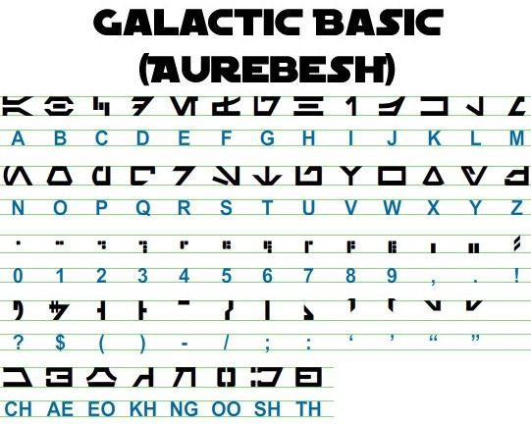
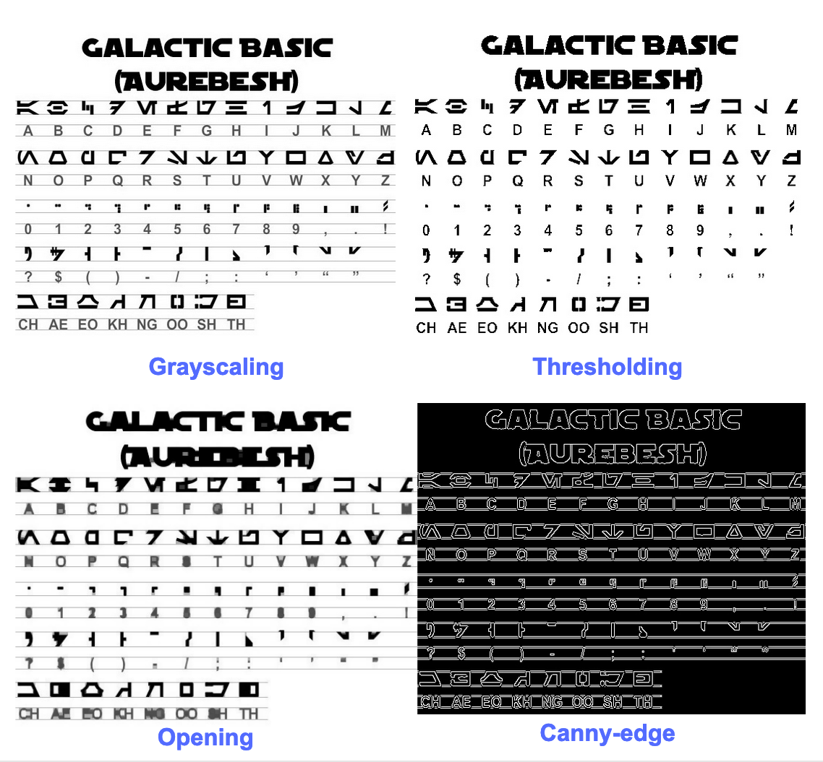
Preprocessing for Tesseract(ex03)
#put Prep4Tesseract.py code above
image = cv2.imread('aurebesh.jpg')
gray = get_grayscale(image)
thresh = thresholding(gray)
opening = opening(gray)
canny = canny(gray)
cv2.namedWindow('original', cv2.WINDOW_NORMAL)
cv2.imshow('original', image)
cv2.namedWindow('gray', cv2.WINDOW_NORMAL)
cv2.imshow('gray', gray)
cv2.namedWindow('thresh', cv2.WINDOW_NORMAL)
cv2.imshow('thresh', thresh)
cv2.namedWindow('opening', cv2.WINDOW_NORMAL)
cv2.imshow('opening', opening)
cv2.namedWindow('canny', cv2.WINDOW_NORMAL)
cv2.imshow('canny', canny)
cv2.waitKey(0)
cv2.destroyAllWindows()

Slide 16
ex03b
import cv2
import numpy as np
import Prep4Tesseract as pt
image = cv2.imread('aurebesh.jpg')
gray = pt.get_grayscale(image)
thresh = pt.thresholding(gray)
opening = pt.opening(gray)
canny = pt.canny(gray)
cv2.namedWindow('original', cv2.WINDOW_NORMAL)
cv2.imshow('original', image)
cv2.namedWindow('gray', cv2.WINDOW_NORMAL)
cv2.imshow('gray', gray)
cv2.namedWindow('thresh', cv2.WINDOW_NORMAL)
cv2.imshow('thresh', thresh)
cv2.namedWindow('opening', cv2.WINDOW_NORMAL)
cv2.imshow('opening', opening)
cv2.namedWindow('canny', cv2.WINDOW_NORMAL)
cv2.imshow('canny', canny)
cv2.waitKey(0)
cv2.destroyAllWindows()

Slide 17
OCR for Gray image(ex04)
import cv2
import pytesseract
import numpy as np
# get grayscale image
def get_grayscale(image):
return cv2.cvtColor(image, cv2.COLOR_BGR2GRAY)
image = cv2.imread('aurebesh.jpg')
gray = get_grayscale(image)
pytesseract.pytesseract.tesseract_cmd = 'C:\\Program Files\\Tesseract-OCR\\tesseract.exe'
h, w, c = image.shape
text = pytesseract.image_to_string(gray, lang="eng")
print(text[0:len(text)-1])
boxes = pytesseract.image_to_boxes(gray)
for b in boxes.splitlines():
b = b.split(' ')
img2 = cv2.rectangle(gray, (int(b[1]), h - int(b[2])), (int(b[3]), h - int(b[4])), (0, 255, 0), 1)
cv2.namedWindow('gray', cv2.WINDOW_NORMAL)
cv2.imshow('gray', gray)
cv2.waitKey(0)
cv2.destroyAllWindows()

Slide 18
Detecting and Recognizing Faces
Understanding Haar cascades.
Finding the pre-trained Haar cascades that come with OpenCV. These include
several face detectors.
Using Haar cascades to detect faces in still images and videos.
Gathering images to train and test a face recognizer.
Using several different face recognition algorithms: Eigenfaces, Fisherfaces, and
Local Binary Pattern Histograms (LBPHs).
Copying rectangular regions from one image to another, with or without a mask.
Using a depth camera to distinguish between a face and the background based
on depth.
Swapping two people's faces in an interactive application.

Slide 19
Getting Haar cascade data
The data/haarcascades folder contains XML files that can be loaded by an OpenCV class called cv2.CascadeClassifier.
An instance of this class interprets a given XML file as a Haar cascade, which provides a detection model for a type of object such as a face.
cv2.CascadeClassifier can detect this type of object in any image. As usual, we could obtain a still image from a file, or we could obtain a series of frames from a video file or a video camera.
Once you find data/haarcascades, create a directory elsewhere for your project; in this folder, create a subfolder called cascades, and copy the following files from data/haarcascades into cascades:
haarcascade_frontalface_default.xml
haarcascade_frontalface_alt.xml
haarcascade_eye.xml

Slide 20
Performing face detection on a still image (ex05)
import cv2
face_cascade = cv2.CascadeClassifier(
'./cascades/haarcascade_frontalface_default.xml')
img = cv2.imread('FaceDetection.jpg')
gray = cv2.cvtColor(img, cv2.COLOR_BGR2GRAY)
faces = face_cascade.detectMultiScale(gray, 1.08, 10)
for (x, y, w, h) in faces:
img = cv2.rectangle(img, (x, y), (x+w, y+h), (255, 0, 0), 2)
cv2.namedWindow('Detected', cv2.WINDOW_NORMAL)
cv2.imshow('Detected', img)
cv2.waitKey(0)
cv2.destroyAllWindows()

Slide 21
Performing face & eyes detection on a still image (ex06)
import cv2
face_cascade = cv2.CascadeClassifier('./cascades/haarcascade_frontalface_default.xml')
eye_cascade = cv2.CascadeClassifier('./cascades/haarcascade_eye.xml')
img = cv2.imread('EyeDetection.png')
img2=img.copy()
gray = cv2.cvtColor(img, cv2.COLOR_BGR2GRAY)
faces = face_cascade.detectMultiScale(gray, 1.08, 10)
for (x, y, w, h) in faces:
img = cv2.rectangle(img, (x, y), (x+w, y+h), (255, 0, 0), 2)
roi_gray = gray[y:y+h, x:x+w]
eyes = eye_cascade.detectMultiScale(roi_gray, 1.03, 5, minSize=(5, 5))
for (ex, ey, ew, eh) in eyes:
cv2.rectangle(img, (x+ex, y+ey),(x+ex+ew, y+ey+eh), (0, 255, 0), 4)
cv2.imshow('Original', img2)
cv2.imshow('Detected', img)
cv2.waitKey(0)
cv2.destroyAllWindows()

Slide 22
Performing face detection on a video (ex07)
import cv2
face_cascade = cv2.CascadeClassifier('./cascades/haarcascade_frontalface_default.xml')
eye_cascade = cv2.CascadeClassifier('./cascades/haarcascade_eye.xml')
camera = cv2.VideoCapture(0)
while (cv2.waitKey(1) == -1):
success, frame = camera.read()
if success:
gray = cv2.cvtColor(frame, cv2.COLOR_BGR2GRAY)
faces = face_cascade.detectMultiScale(gray, 1.3, 10, minSize=(50, 50))
for (x, y, w, h) in faces:
cv2.rectangle(frame, (x, y), (x+w, y+h), (255, 0, 0), 2)
roi_gray = gray[y:y+h, x:x+w]
eyes = eye_cascade.detectMultiScale(roi_gray, 1.03, 10, minSize=(40, 40))
for (ex, ey, ew, eh) in eyes:
cv2.rectangle(frame, (x+ex, y+ey),(x+ex+ew, y+ey+eh), (0, 255, 0), 2)
cv2.imshow('Face Detection', frame)
cv2.destroyAllWindows()
camera.release()

Slide 23
Performing face recognition
A large directory of face databases is available online at http:/ / www. face- rec.org/ databases/ .
Here are a few notable examples from the directory:
Yale Face Database (Yalefaces): http://vision.ucsd.edu/content/yale-face-database
Extended Yale Face Database B: http:/ / vision. ucsd. edu/ content/ extendedyale-face- database- b- b
Database of Faces (from AT&T Laboratories Cambridge): http://www.cl.cam.ac.uk/research/dtg/attarchive/facedatabase.html

Slide 24
Generating the data for face recognition
Steps for face recognition
Generating the data for face recognition
generate_training_faces.py
Loading the training data for face recognition
face_recognition_video.py

Slide 25
Introduction to Neural Networks with OpenCV
Understanding neurons and perceptrons
Understanding the layers of a neural network
Understanding the layers of a neural network
Training a basic ANN in OpenCV
Recognizing handwritten digits with an ANN

Slide 26


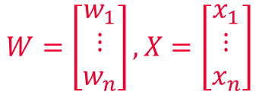
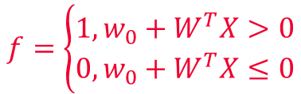
Understanding neurons and perceptrons
$$y=f\left(w_{0}+w_{1}x_{1}+…+w_{n}x_{n}\right)$$
$$=f\left(w_{0}+W^{T}X\right)$$
$$f=\left\{\begin{aligned}1,w_{0}+W^{T}X>0 \\ 0,w_{0}+W^{T}X≤0\end{aligned}\right.$$
$$W=\left[\begin{aligned}w_{1} \\ ⋮ \\ w_{n}\end{aligned}\right], X=\left[\begin{aligned}x_{1} \\ ⋮ \\ x_{n}\end{aligned}\right]$$
An ANN is designed as a multi-layer perceptron(MLP)
Each neuron acts as a kind of binary classifier called a perceptron.
A perceptron is a function that takes a number of inputs and produces a single value.
Each of the inputs has an associated weight that signifies its importance in an activation function. The activation function should have a nonlinear response; for example, a sigmoid function (sometimes called an S-curve) is a common choice.
A threshold function, called a discriminant, is applied to the activation function's output to convert it into a binary classification of 0 or 1.

Slide 27
Understanding the layers of a neural network
As the preceding diagram shows, there are at least three distinct layers in a neural network: the input layer, the hidden layer, and the output layer.
There can be more than one hidden layer; however, one hidden layer is enough to resolve many real-life problems.
A neural network with multiple hidden layers is sometimes called a deep neural network (DNN).

Slide 28
determine the network's topology-01
Choosing the size of the input layer
The number of nodes in the input layer is, by definition, the number of inputs into the network.
For example, let's say you want to create an ANN to help you determine an animal's species based on measurements of its physical attributes.
Choosing the size of the output layer
For a classifier, the number of nodes in the output layer is, by definition, the number of
classes the network can distinguish. Continuing with the preceding example of an animal
classification network, we can use an output layer of four nodes if we know we are going to
deal with the following animals: dog, condor, dolphin, and dragon(!).
Choosing the size of the hidden layer------next page

Slide 29
determine the network's topology-02
Choosing the size of the hidden layer
There are no agreed-upon rules of thumb for choosing the size of the hidden layer; it must be chosen based on experimentation.
If the input layer is large, the number of hidden neurons should be between the size of the input layer and the size of the output layer – and, typically, closer to the size of the output layer.
On the other hand, if the input and output layers are both small, the hidden layer should be the largest layer.
If the input layer is small but the output layer is large, the hidden layer should be closer to the size of the input layer.

Slide 30
Training a basic ANN in OpenCV (simple_ann.py)
import cv2
import numpy as np
ann = cv2.ml.ANN_MLP_create()
ann.setLayerSizes(np.array([9, 15, 9], np.uint8))
ann.setActivationFunction(cv2.ml.ANN_MLP_SIGMOID_SYM, 0.6, 1.0)
ann.setTrainMethod(cv2.ml.ANN_MLP_BACKPROP, 0.1, 0.1)
ann.setTermCriteria((cv2.TERM_CRITERIA_MAX_ITER | cv2.TERM_CRITERIA_EPS, 100, 1.0))
training_samples = np.array([[1.2, 1.3, 1.9, 2.2, 2.3, 2.9, 3.0, 3.2, 3.3]], np.float32)
layout = cv2.ml.ROW_SAMPLE
training_responses = np.array([[0.0, 0.0, 0.0, 0.0, 0.0, 1.0, 0.0, 0.0, 0.0]], np.float32)
data = cv2.ml.TrainData_create(training_samples, layout, training_responses)
ann.train(data)
test_samples = np.array([[1.4, 1.5, 1.2, 2.0, 2.5, 2.8, 3.0, 3.1, 3.8]], np.float32)
prediction = ann.predict(test_samples)
print(prediction)

Slide 31
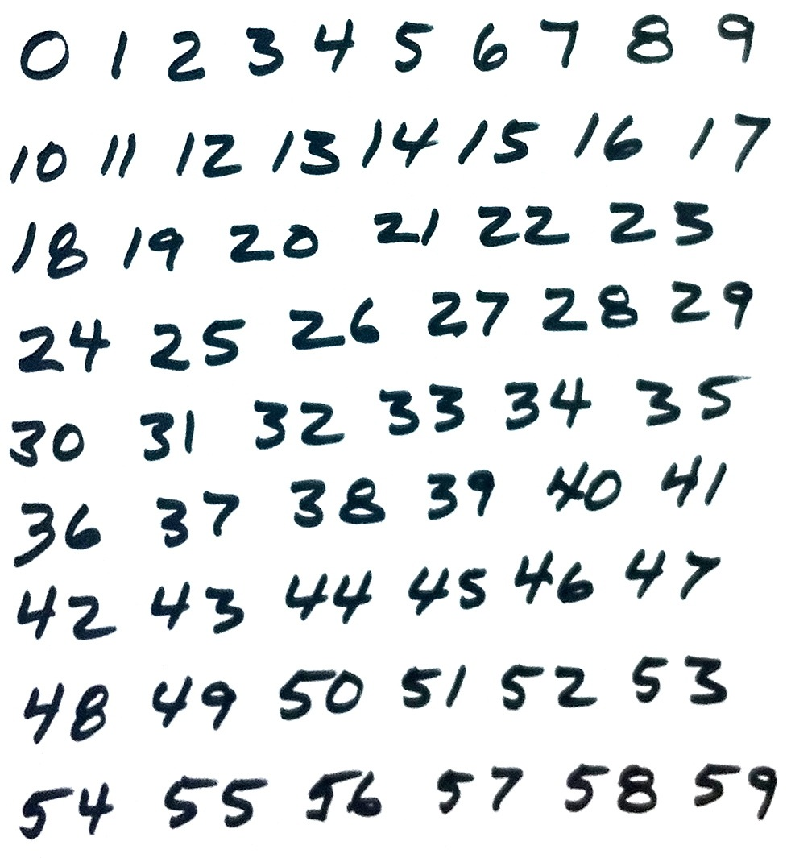
Recognizing handwritten digits with an ANN

Slide 32
Understanding the MNIST database of handwritten digits
The MNIST database (or Modified National Institute of Standards and Technology database) is publicly available at http:/ / yann. lecun. com/ exdb/ mnist/ .
The database includes a training set of 60,000 images of handwritten digits. Half of these were written by employees of the United States Census Bureau, while the other half were written by high school students in the United States.
The database also includes a test set of 10,000 images, gathered from the same writers.
All the training and test images are in grayscale format, with dimensions of 28 x 28 pixels. The digits are white (or shades of gray) on a black background. For example, here are three of the MNIST training samples:

Slide 33
Choosing training parameters for the MNIST database
Each MNIST sample is an image containing 784 pixels (that is, 28 x 28 pixels).
Thus, our ANN's input layer will have 784 nodes. The output layer will have 10 nodes because there are 10 classes of digits (0 to 9).
Implementing a module to train the ANN
digits_ann.py
Implementing a minimal test module
detect_and_classify_digits.py

Slide 34
Trying to improve the ANN's training
You could experiment with the size of your training dataset, the number of hidden nodes, and the number of epochs until you find a peak level of accuracy.
You could modify our digits_ann.create_ann function so that it supports more than one hidden layer.
You could also try different activation functions. We have usedcv2.ml.ANN_MLP_SIGMOID_SYM, but it isn't the only option; the others include cv2.ml.ANN_MLP_IDENTITY, cv2.ml.ANN_MLP_GAUSSIAN, cv2.ml.ANN_MLP_RELU, and cv2.ml.ANN_MLP_LEAKYRELU.
Similarly, you could try different training methods. We have used cv2.ml.ANN_MLP_BACKPROP. The other options include cv2.ml.ANN_MLP_RPROP and cv2.ml.ANN_MLP_ANNEAL.

Slide 35
Using DNNs from other frameworks in OpenCV
OpenCV can load and use DNNs that have been trained in any of the following frameworks:
Caffe (http:/ / caffe. berkeleyvision. org/ )
TensorFlow (https:/ / www. tensorflow. org/ )
Torch (http:/ / torch. ch/ )
Darknet (https:/ / pjreddie. com/ darknet/ )
ONNX (https:/ / onnx. ai/ )
DLDT (https:/ / github. com/ opencv/ dldt/ )

Slide 36
Detecting and classifying faces with thirdparty DNNs
age and gender classification
age_net.caffemodel: This is the DNN for age classification.
age_net_deploy.protext: This is the text file that describes the parameters of the preceding DNN for age classification.
gender_net.caffemodel: This is the DNN for gender classification.
gender_net_deploy.protext: This is the text file that describes the parameters of the preceding DNN for age classification.
average_face.npy and average_face.png: These files represent the average faces in the classifiers' training dataset. The original file from Levi and Hassner is called mean.binaryproto, but we have converted it into a NumPy-readable format and a standard image format, which are more convenient for our purposes.
faces_dnn.py

